Slide 1
Product Review Insights
Amsterdam
July 24th 2018
Kuanysh Italmassov

Slide 2
Objective
Analyze products reviews at Amazon and its application in business

Slide 3
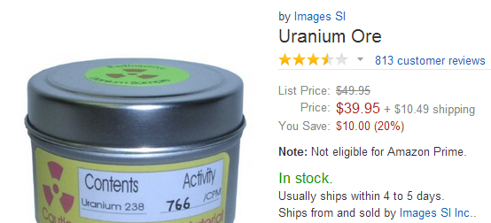
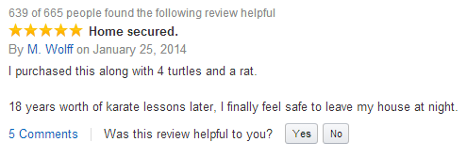
Product reviews at glance
93% of products have at least 1 review, 24% have 5 and more reviews
Over 2 million products have 5 or more reviews
Average review is 4.21 points, with 58% of reviews being 5 stars
Category with highest average rating is Music (4.43), lowest is Appliances(3.27)

Slide 4
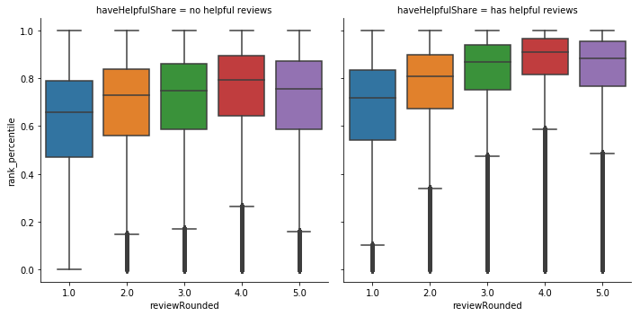
Sales ranking
Products without “helpful“ reviews
Products with “helpful“ reviews
On average the higher the average review is the higher is sales ranks product appears
On average 1 point of review gains additional 1.6% in sales ranks, when accounting for price*
If reviews are helpful they are associated with higher sales rank
*Linear regression model: Rank Percentile ~ Category Price Percentile + Average Review

Slide 5
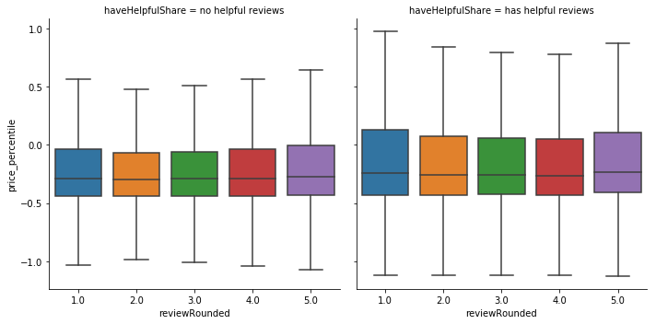
Price level
Products without “helpful“ reviews
Products with “helpful“ reviews
No significant evidence that higher average review is correlated with higher price both for reviews without feedback and ones that were found
Assumingly it is because price is set independently of reviews

Slide 6
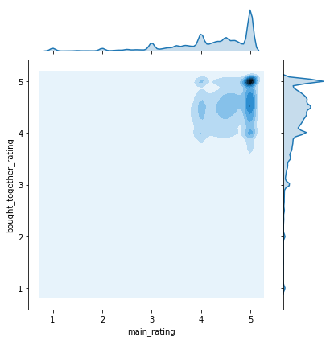
Bought together products
Ratings of Products Bought Together
Products that bought together have minor correlation of their ratings - 23%
This is not primary connection between two products as following factors have higher correlation:
Sales rank in category – 45%
Price rank in category – 39%

Slide 7
Summary
Large Reviews Dataset is extensive source of products evaluation by customers and one of Amazon’s competitive advantages
Average rating is associated with higher place in sales ranking and it could be used as predictor for forecasting demand and stock management
Helpfulness of review is important for product sales rank
Rating is not significantly associated with product price in our business model
Average rating has minor prediction value in identifying product bought together

Slide 8
Recommendations
Consider adding product rating in demand forecast model
Developing recommendation model, when no data for collaborative filtering, consider adding review ratings together with products sales rank, price rank and others
Consider providing minor discount for users when they reviews considered highly helpful. If confirmed build a model that recommends how to change review to be more helpful (NLP with Neural Networks)

Slide 9
Backup

Slide 10
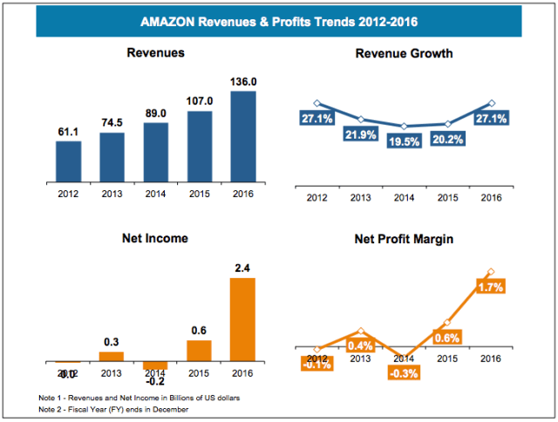
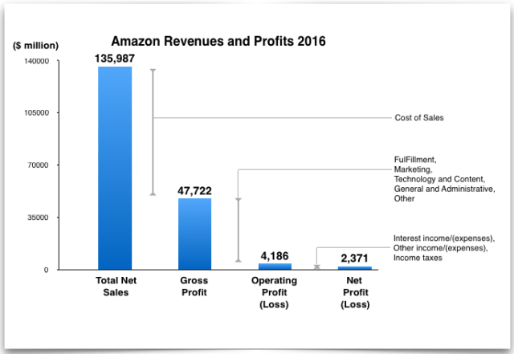
Amazon Revenue & Profit
Strong growth of revenue and profit margin over
Sustainable gross profit margin of 35.1%
Source: https://revenuesandprofits.com/amazon-revenues-profits-analysis-2017-update/

Slide 11
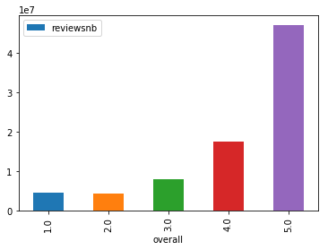
Distribution of Ratings
Source: https://revenuesandprofits.com/amazon-revenues-profits-analysis-2017-update/

Slide 12
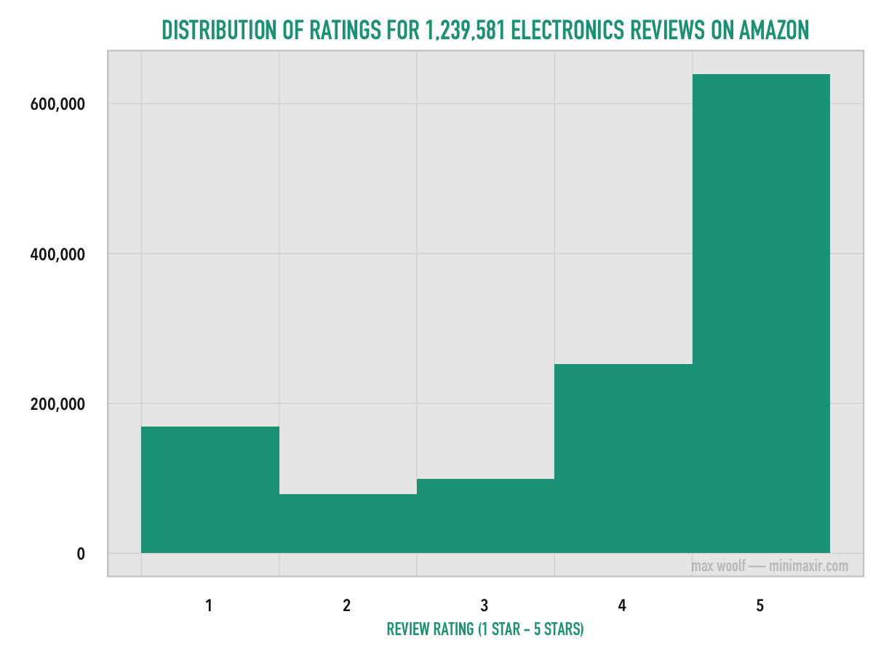
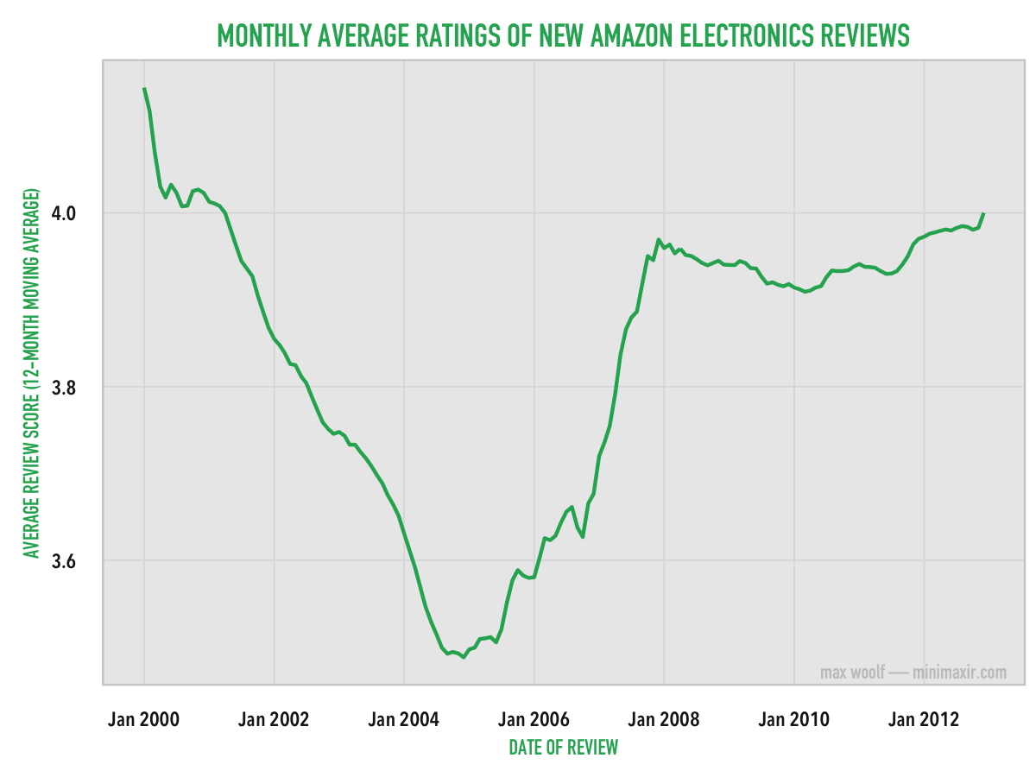
Previous Analysis
Source: http://minimaxir.com/2014/06/reviewing-reviews/

Slide 13
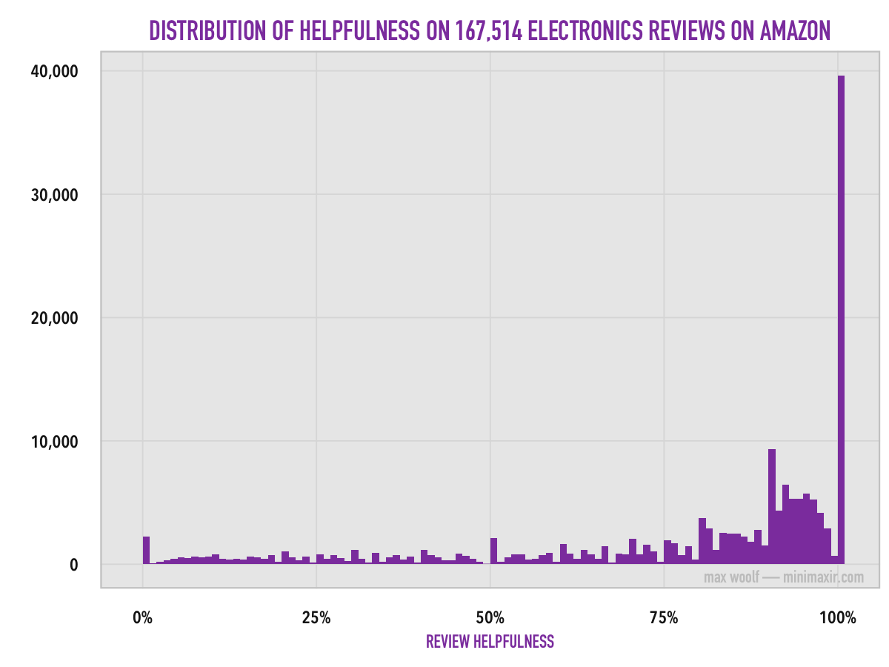
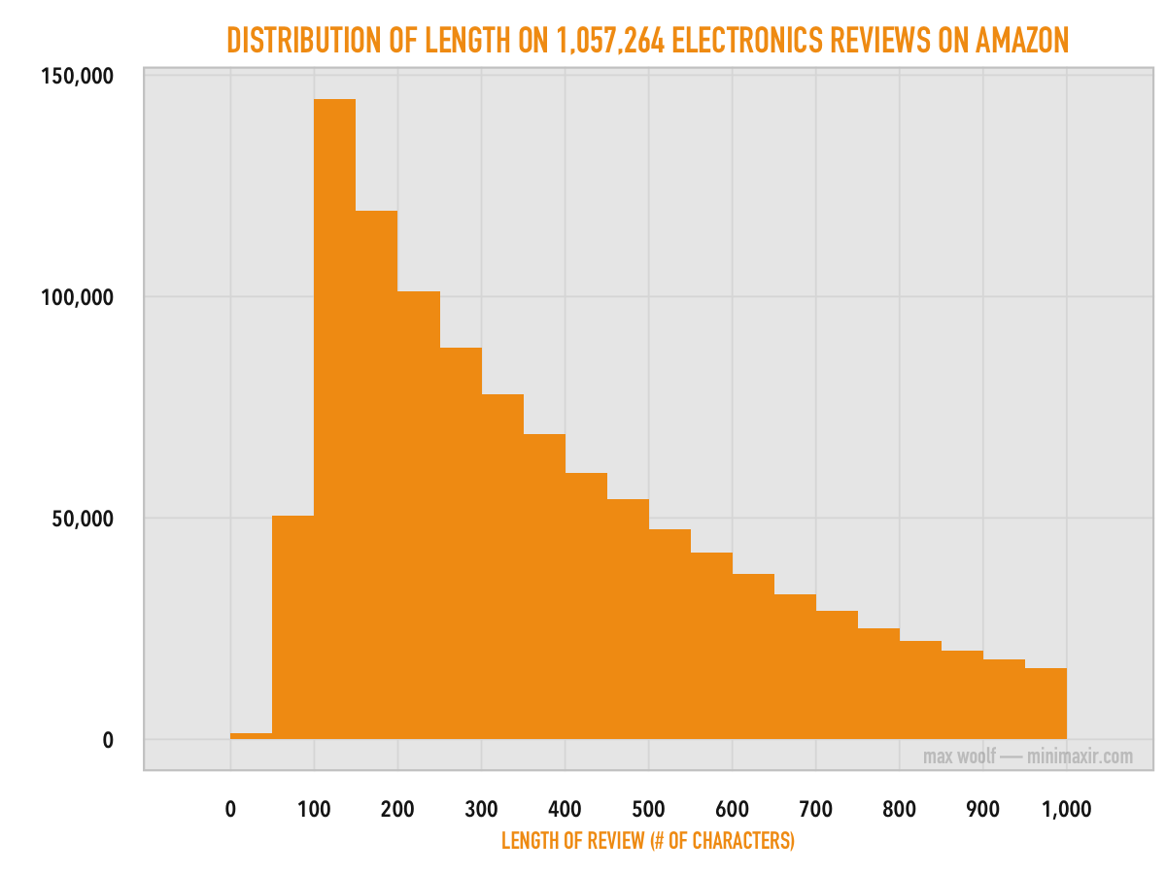
Previous Analysis
Source: http://minimaxir.com/2014/06/reviewing-reviews/

Slide 14
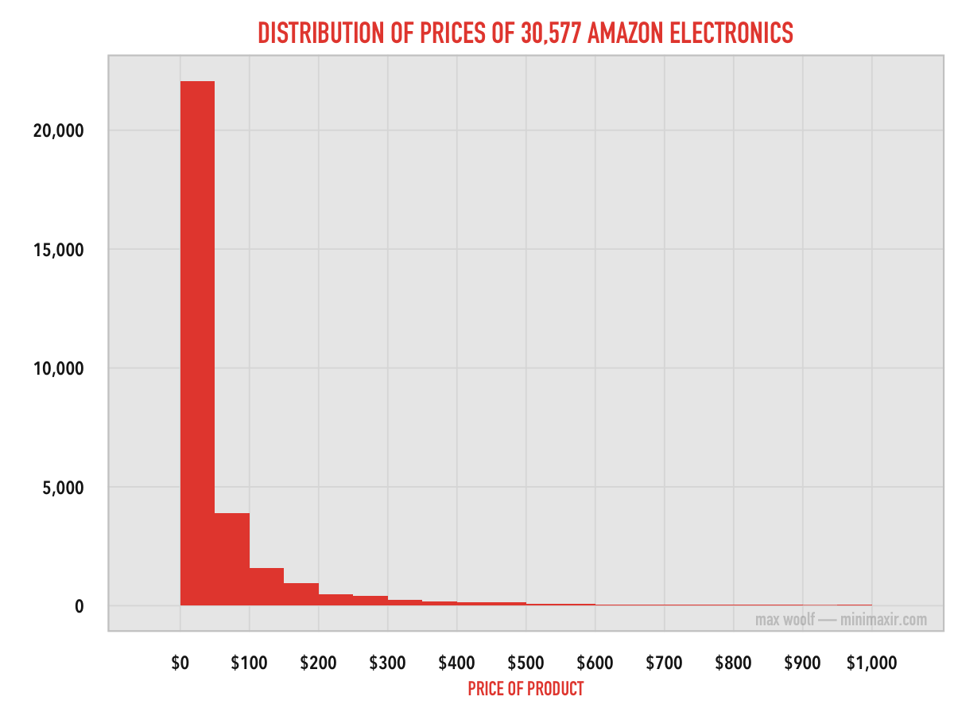
Previous Analysis
However, there’s no statistical correlation between the price of a product and the number of reviews it receives.
Source: http://minimaxir.com/2014/06/reviewing-reviews/

Slide 15
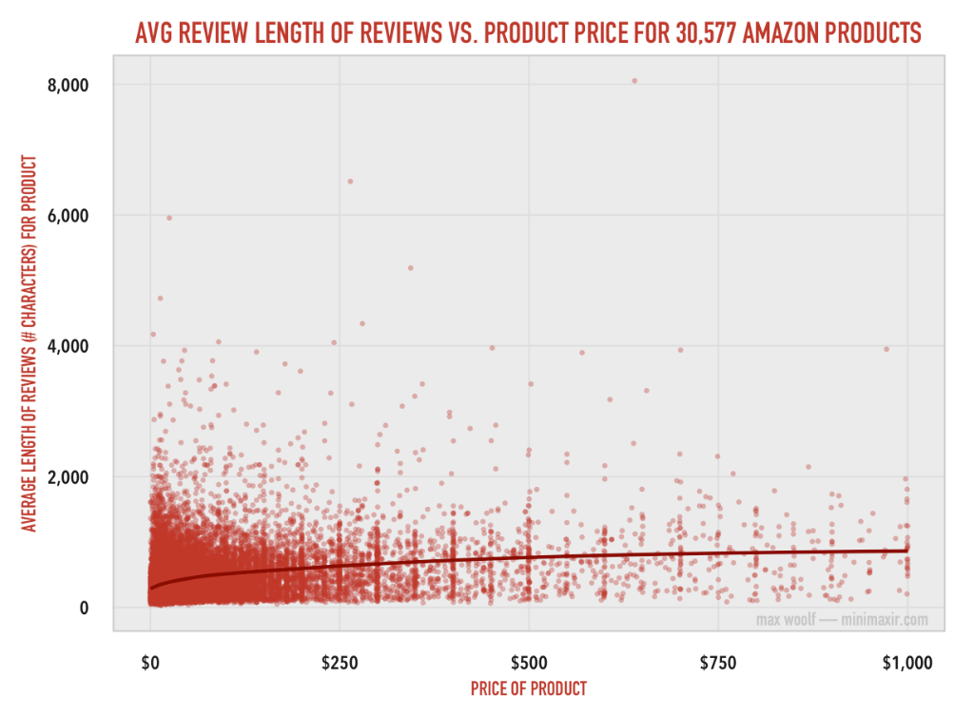
Previous Analysis
This relationship is logarithmic with a relatively good correlation (r = 0.29), and it shows that reviewers put more time and effort into reviewing products which are worth more.
Source: http://minimaxir.com/2014/06/reviewing-reviews/

Slide 16
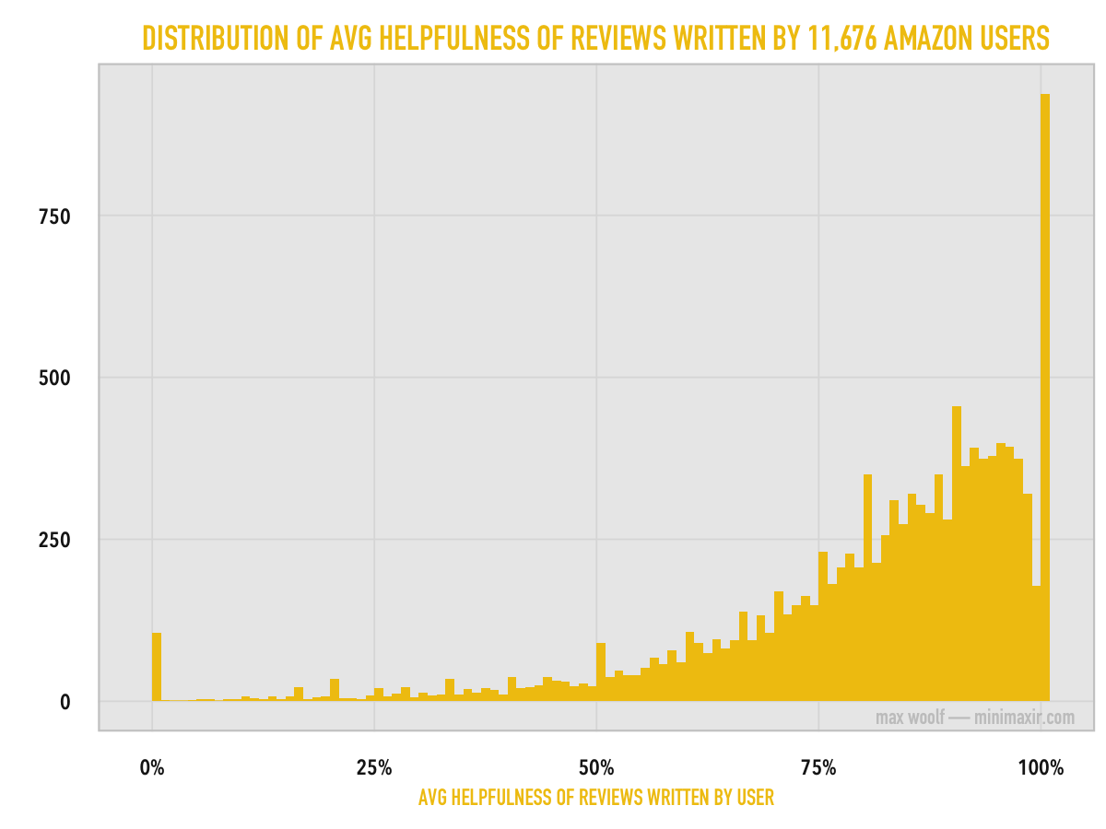
Previous Analysis
What about the average helpfulness of the reviews written by a single reviewer? If a reviewer has enjoyed Amazon enough such that they make 5 or more reviews, chances are that their reviews are high quality.
Source: http://minimaxir.com/2014/06/reviewing-reviews/

Slide 17
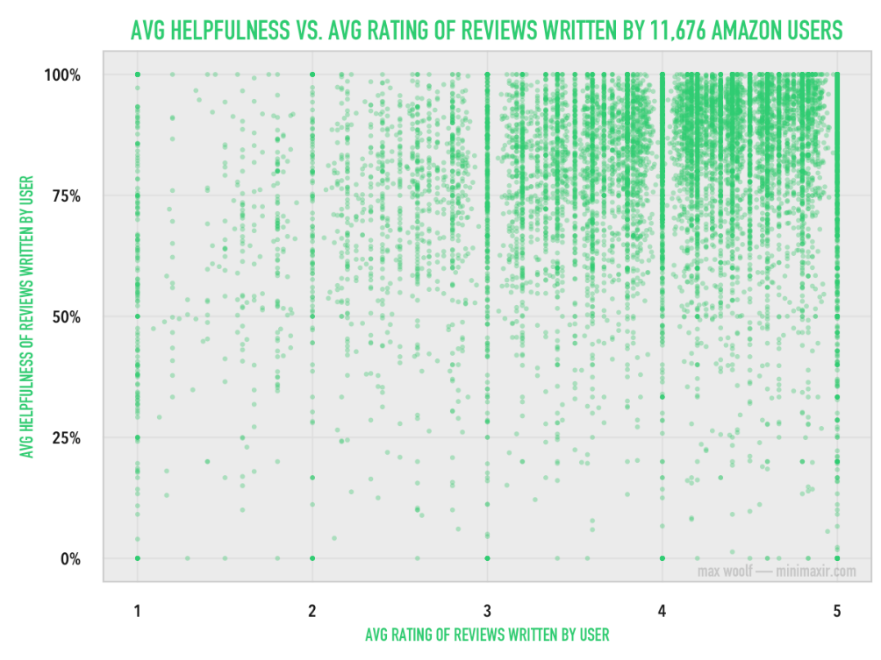
Previous Analysis
As the chart shows, there’s a good positive correlation (r = 0.27) between rating and helpfulness, with a discernible cluster at the top. However, I don’t think it’s a causal relationship. Reviewers who give a product a 4 - 5 star rating are more passionate about the product and likely to write better reviews than someone who writes a 1 - 2 star “this product sucks and you suck too!” review.
Source: http://minimaxir.com/2014/06/reviewing-reviews/

Slide 18
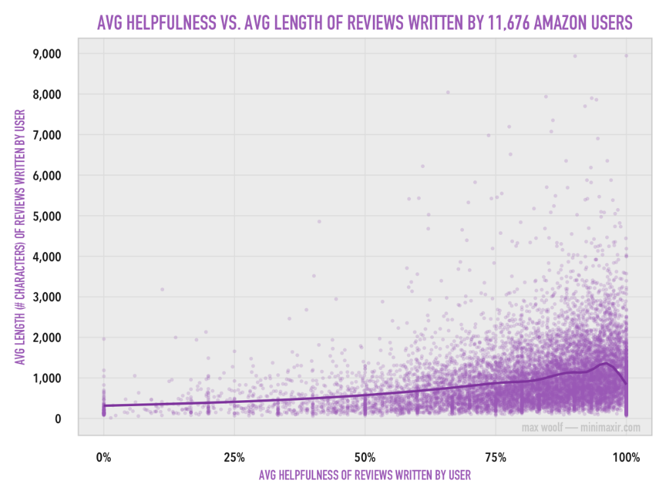
Previous Analysis
Again, there’s a good positive correlation (r = 0.26) between average helpfulness and average length, which the trend line supports. (the dip at the end is caused by the high amount of low-character reviews). All the longer reviews have high helpfulness; there are very, very few unhelpful reviews that are also long.
Source: http://minimaxir.com/2014/06/reviewing-reviews/

